Slide 1
ENGR 216 – Spring 2019
Class 06
Engineering and Art

Slide 2
Disclaimer
I’m not an artist.
That doesn’t mean I can’t recognize a great (artistic) design when I see it.
Though, I’ve misjudged many products—in both ways. I’ve seen products I thought were “can’t miss” yet they ended up in a landfill near you. Others I thought were duds yet millions were sold.

Slide 3
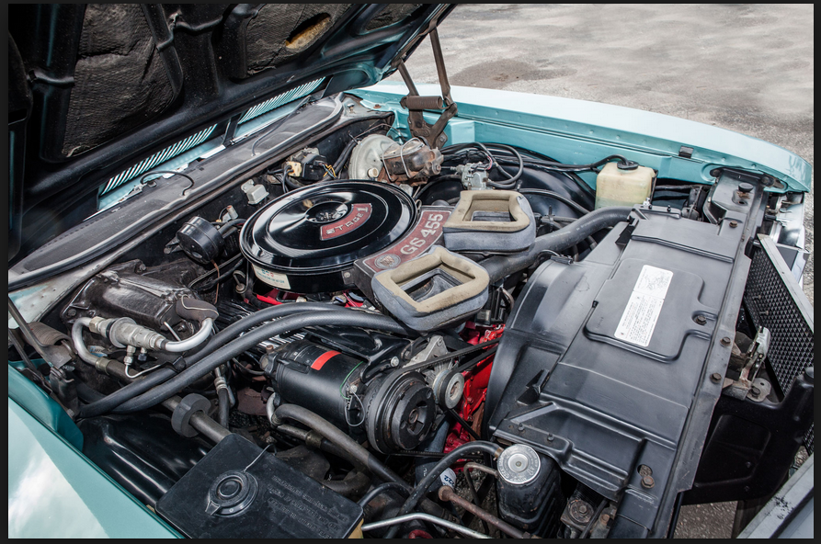
Is this Art?
Notes:
You should get disagreement within the class. Some think this is art, as it speaks to them.
GM got a lot of pushback from both customers and stakeholders (repairmen) that so many hoses, wires, belts, etc. that under the hood was just a mess.
Most new cars have eliminated most of the vacuum hoses. Engine covers are pretty standard to “tidy up” the engine bay.

Slide 4
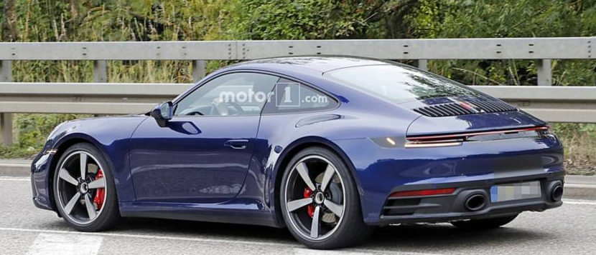
Or this?

Slide 5
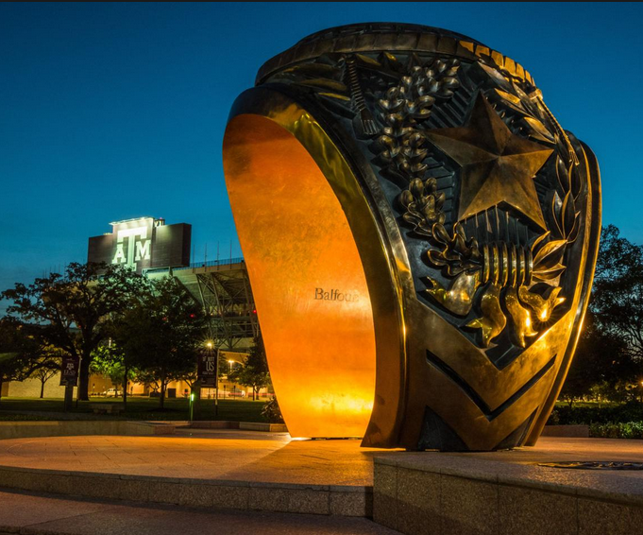
Or this?

Slide 6
What is Art?
the expression or application of human creative skill and imagination, typically in a visual form such as painting or sculpture, producing works to be appreciated primarily for their beauty or emotional power.
works produced by human creative skill and imagination.
subjects of study primarily concerned with the processes and products of human creativity and social life, such as languages, literature, and history (as contrasted with scientific or technical subjects).
a skill at doing a specified thing, typically one acquired through practice.
Google lookup of “art”
Notes:
Art is something that should speak to the person who is experiencing it.
Some will think something is art, while others may think of it as, shall we say “not art.”

Slide 7
What in engineering that is close to art?
Your thoughts . . .
Notes:
You can have the students break into groups and discuss it.

Slide 8
So What makes for a Great Design? (According to Steve Jobs)
Craft (above all—things not visible should have same craftsmanship as the portion that is visible)
Empathy (intimate connection to the user)
Focus (eliminate all unimportant opportunities)
Impute (people for opinions on a company or product based on signals that it conveys)
Friendliness (May have been Job’s biggest contribution)
Simplicity (and should be linked to making products easier to use)
https://www.fastcompany.com/1665375/the-6-pillars-of-steve-jobss-design-philosophy
Notes:
I’ve included the article that discusses these six pillars

Slide 9
Some other aspects of good design and art
Make use of symmetry
Golden ratio
Optical illusion (leaves you wondering, “now how does that work?” or looks like it would perform one function but actually does another)
Hide the wires

Slide 10
HW6
Watch the videos on the art in ZACH building and read summary Assignment on eCampus:
eCampus multisection (“Art in Engineering” tab)
You don’t have to do the quizzes
Go visit two of the pieces of art here in Zachry from the Assignment. Study it.
Do the following:
Explain each
Tell why you chose them
Explain what each means to you. Does it relate to your engineering education or your ultimate goal? Why or Why not?
2-3 pages
Notes:
There are no wrong answers to this homework. It can be the Albritton Bell Tower on Old Main, statue of Reveille, whatever interests the student . . . .

